Slide 1





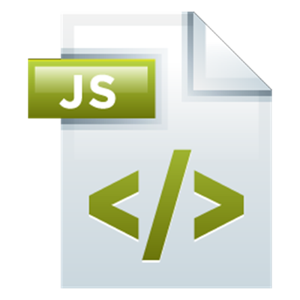
Modules in JS
Modules, Babel, RequireJS, Other JavaScript Module Systems
Modules
SoftUni Team
Technical Trainers
Software University
http://softuni.bg

Slide 2


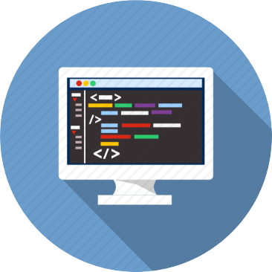
Table of Contents
Modular Code in JS
Formats and Loaders
Native Syntax in ES6
Transpilers

Slide 3
Have a Question?
sli.do #JSCORE

Slide 4


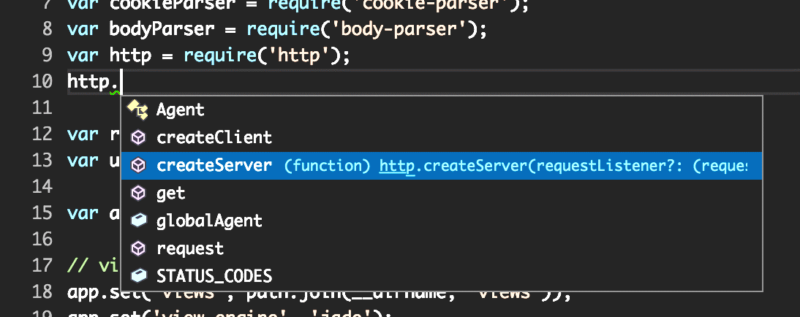
Modular Code
Concepts

Slide 5
What is a Module?
persons.js
class Person {
constructor(name) {
this.name = name;
}
toString() {
return `I'm ${this.name}`;
}
}
module.exports = Person;
app.js
let Person = require('./person');
let p = new Person('Pesho');
console.log(p.toString());

Slide 6
Submitting Modules in the Judge
SoftUni Judge (https://judge.softuni.bg) submissions should consist of a zip file, containing all required files
Attach members as requested by the problem description as properties of the result object:
The entry point of your solution is ALWAYS app.js
let Person = require('./person');
result.Person = Person;
Check your solution here: https://judge.softuni.bg/Contests/342

Slide 7
Modular Code
Reduced global scope pollution
Improved performance - only load the code that is needed
Easier to maintain
Interchangeable code - use parts of one application in another
Controller
Model
View

Slide 8
IIFE
An Immediately-Invoked Function Expression
Maintains hidden state
Limits the exposure of variables
let count = (function() {
let counter = 0;
return function() { counter++; }
})();

Slide 9
Revealing Module Pattern
Expands the IIFE concept
Return objects with internal state and complex functionality
let revModule = (function() {
let counter = 0; // private
function increase(num) { counter += num; }
function decrease(num) { counter -= num; }
function value() { return count; }
return { increase, decrease, value }; // public
})();

Slide 10



Module Systems for JS
Formats and Loaders

Slide 11
Formats and Loaders
Module Format → Syntax
Module Loader → Execution
JavaScript
AMD
Edge
Chrome
Firefox
Require
Curl.js
SystemJS
Notes:
Formats define syntax
Loaders do the actual work
Each loader supports different syntaxes
Loaders are external libraries
ES6 introduces native support for modular code

Slide 12
Formats
Node.js uses CommonJS
Asynchronous Module Definition
(AMD)
CommonJS
Universal
Module Definition
(UMD)
System.register
ES6 Format
Notes:
Asynchronous Module Definition (AMD) – used in browsers
CommonJS – used server-side, built-into NodeDJ
Universal Module Definition (UMD) – compatible with many loaders, used mostly as part of a pipeline with another language
System.register – syntax for SystemJS loader, wont be needed since the loader supports CommonJS
Native ES6

Slide 13
Loaders
RequireJS
Most popular for browsers
Works with AMD format
SystemJS
Prefered on server-side implementations
Supports AMD, CommonJS, UMD, System.register
CommonJS is used by Node.js

Slide 14


AMD and RequireJS
Syntax and Configuration

Slide 15
AMD and RequireJS
External dependancies
Dependencies received as parameters
define(['./player'], function(player) {
console.log(`Starting game for ${player.getName()}`);
function calculateScore() {
// calculate the score here
}
return {
calculateScore: calculateScore
};
});
Exported members

Slide 16
Installing RequireJS
Download RequireJS using WebStorm's terminal
Or download from requirejs.org
Use a script tag with data-main set to your app's path
npm install --save requirejs
<script data-main="./app.js" src="node_modules/requirejs/require.js">
</script>
Note: It's best if your project has a package.json file

Slide 17
CommonJS and System.js
Syntax and Configuration

Slide 18
CommonJS and SystemJS
External dependancies
let player = require('./player.js');
console.log(`Starting game for ${player.getName()}`);
function calculateScore() {
// calculate the score here
}
exports.calculateScore = calculateScore;
Exported members
// module.exports === exports

Slide 19
Installing SystemJS
Download SystemJS using WebStorm's terminal
You can find documentation at SystemJS' github
Node.js supports CommonJS format natively – you don't need to download anything if you're writing a node module
npm install --save systemjs
Note: It's best if your project has a package.json file

Slide 20
Configuring SystemJS
Load the library in your host HTML
Configure and load your app's path
<script src="node_modules/systemjs/dist/system.js">
</script>
<script>
System.config({ meta: { format: 'cjs' } });
System.import('./app.js');
</script>

Slide 21
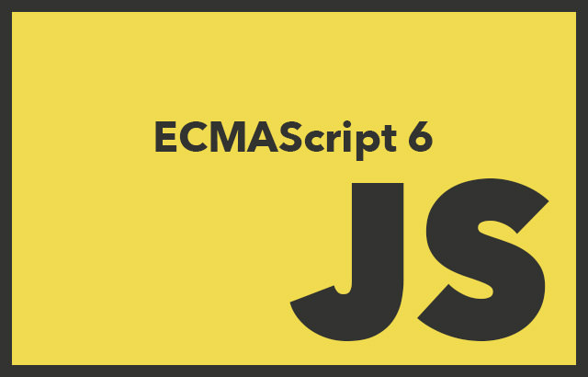

ES6 (Harmony) Modules
modules
Syntax and Configuration

Slide 22
ES6 Native Modules
Functions similar to module formats
Dependency management
Hide from scope and expose explicitly
Used from Angular, React, Ember
Some major differences
Cleaner syntax
Slightly better performance
modules

Slide 23
ES6 Export Syntax
export → expose public API
You can export multiple members
Default exports can be imported without a name
export function updateScoreboard(newResult) { … }
export let homeTeam = 'Tigers';
export { addResult, homeTeam as host };
export default function addResult(newResult) { … }

Slide 24
ES6 Import Syntax
import → load dependency
Import specific members
Import default member by specifying alias
import * as scoreboard from './scoreboard.js';
scoreboard.updateScore(); // call from module
import {addResult, homeTeam} from './scoreboard.js';
addResult(); // call directly by name
import addResult from './scoreboard.js';
addResult(); // call directly by name

Slide 25


Transpilers
Using Babel to Transpile ES6 Modules

Slide 26
Workflow with Transpilers
Transpilers convert source code from one language to another
Or from one version to another of the same language
Development
Runtime
ES6
Modules
AMD, CommonJS, etc.
RequireJS, SystemJS, etc.
Transpiler

Slide 27
Transpiling with Babel
Babel allows us to use the latest JS features in today's browsers
Creates clean and readable code
Integrates seamlessly into WebStorm
Object.defineProperty(
exports, "__esModule",
{ value: true });
exports.getScore = getScore;
function getScore() {
// get score
}
export function getScore() {
// get score
}

Slide 28
Installing Babel
Download Babel-CLI globally using WebStorm's terminal
Configure WebStorm with the correct path to babel.cmd
You can find documentation at babeljs.io
Babel requires plug-ins to work
npm install --save-dev babel-cli -g
Note: It's best if your project has a package.json file

Slide 29
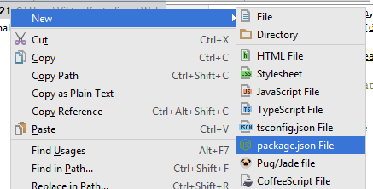
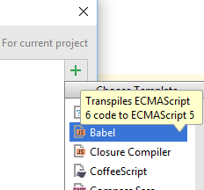
Babel Configuration Cheat Sheet
To create a package.json file:
Right-click project → New → package.json
To add a file watcher:
File → Settings → Tools → File Watchers → Add (Top Right) → Babel
Quick settings:
Program: (path to) node_modules\.bin\babel.cmd
Arguments: $FilePathRelativeToProjectRoot$ --source-maps --out-dir build
Working dir: $ProjectFileDir$
Output paths: build
Name of output directory

Slide 30
Configuring for AMD and RequireJS
Download the plugin from WebStorm's terminal
Create a .babelrc configuration file in the project's root
To load the resulting files, you also need RequireJS installed
npm install --save-dev babel-plugin-transform-es2015-modules-amd
echo { "plugins": ["transform-es2015-modules-amd"] } > .babelrc
Note: It's best if your project has a package.json file

Slide 31
Configuring for CommonJS and SystemJS
Download the plugin from WebStorm's terminal
Create a .babelrc configuration file in the project's root
To load the resulting files, you also need SystemJS installed
npm install --save-dev babel-plugin-transform-es2015-modules-commonjs
echo { "plugins": ["transform-es2015-modules-commonjs"] } > .babelrc
Note: It's best if your project has a package.json file

Slide 32

Practice: Writing Modular Code
Live Exercises in Class (Lab)

Slide 33


Summary
Modular code improves workflow
JS files can be loaded with external libraries
ES6 gives us built-in module support
Use the latest features today with Transpilers
import addResult from './scoreboard';
export { homeTown as host };

Slide 34








Modules in JS
https://softuni.bg/courses/

Slide 35
License
This course (slides, examples, demos, videos, homework, etc.) is licensed under the "Creative Commons Attribution-NonCommercial-ShareAlike 4.0 International" license

Slide 36





Free Trainings @ Software University
Software University Foundation – softuni.org
Software University – High-Quality Education, Profession and Job for Software Developers
softuni.bg
Software University @ Facebook
facebook.com/SoftwareUniversity
Software University Forums
forum.softuni.bg

